Slide 1
Course: Programming Fundamentals
4.00 Credit Hours, Fall 2018,
Graduate Program
Instructor: Maryam Ehsan

Slide 2
Today’s lecture outline
Introduction to structure programming
Function definition
Function call
Function prototype

Slide 3
Structured programming
It enables programmers to break complex systems into manageable components
In C/C++, these components are known as functions
A function is a block of statements that perform a task
Every C/C++ program can be thought of as a collection of these functions

Slide 4
Structured programming concepts
Top-down design
Code reusability
Information hiding

Slide 5
Top-down design
To demonstrate let see ATM (Automated Teller Machine) as an example
Question for you is where to begin as it's a large task filled with complexities and many details

Slide 6
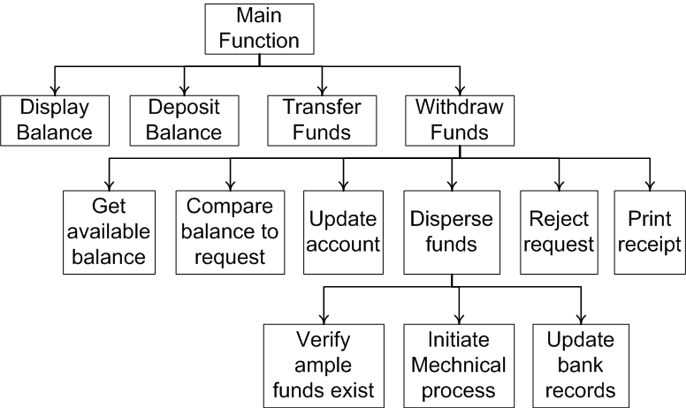
Decomposing ATM system—top-down design

Slide 7
C programming
main()
{
….
….
DisplayBalance()
….
….
….
….
….
TransferFunds()
….
….
}
DisplayBalance()
{
…..
…..
}
TransferFunds()
{
…..
…..
}

Slide 8
Code Reusability
Code reusability is implemented as functions in C/C++
Consider the following list of components and subcomponents from the ATM example in the previous section
Get available balance
Compare available balance to amount requested
Update customer’s account
Distribute approved funds
Reject request
Print receipt

Slide 9
Code reusability – other examples
printf(….) function
scanf(….) function
system function
system(“pause”);
system(“cls”);

Slide 10
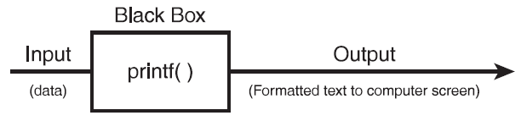
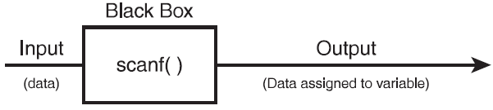
Information Hiding
Information hiding is a conceptual process by which programmers hide implementation details into functions
Functions can be seen as black boxes
Black box is simply a component that performs a task
You don't know how the black box performs the task
data
Formatted text to screen
data
Data assigned to variable

Slide 11
Function
A function is a self-contained block of statements that perform a task
Every C/C++ program can be thought of as a collection of these functions
using a function is like hiring a person to do a specific job
Sometimes the interaction with this person is very simple; sometimes it’s complex.

Slide 12
Function call and definition
main()
{
message();
printf(“Hello world \n”);
}
Function call
Waiting
message()
{
printf(“Message function \n”);
}
Function definition

Slide 13
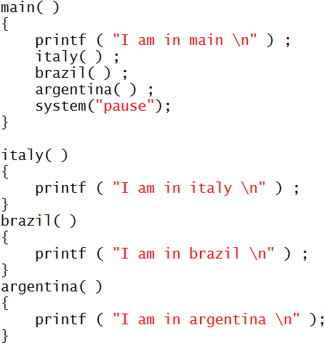
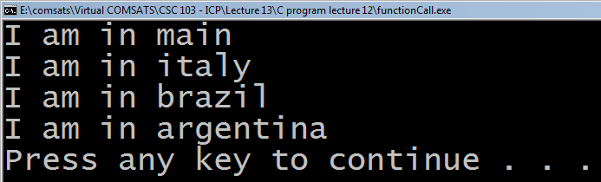
Example program 1

Slide 14
Points to remember
C program must contains at least one function
Execution of C/C++ program begins with main() function.
If there are more than one function then one function must be main()
There is no limit on number of functions in C/C++ program
Functions in a program are called in sequence as mentioned in main() function
After the execution of function control returns to main()

Slide 15
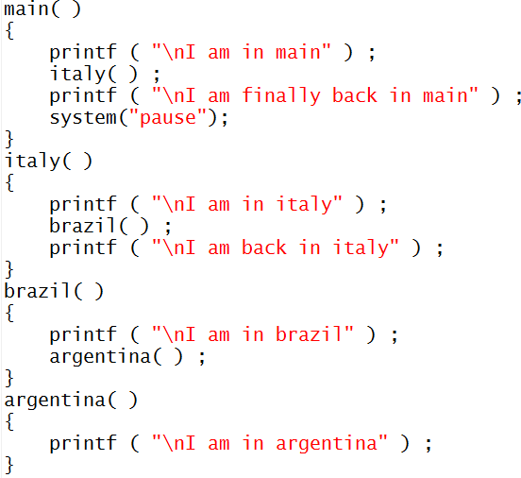
Example program 2
I am in main
I am in italy
I am in brazil
I am in argentina
I am back in italy
I am finally back in main
Press any key to continue

Slide 16
Function prototype
Function prototypes tell C/C++ how your function will be built and used
Function prototype contains following things about the function:
The data type returned by the function
The number of parameters received
The data types of the parameters
The order of the parameters

Slide 17

Cont.
It is not always necessary
to send input as parameters to functions
to have functions return values
In such case programmer mention that function are void of parameter and return value

Slide 18
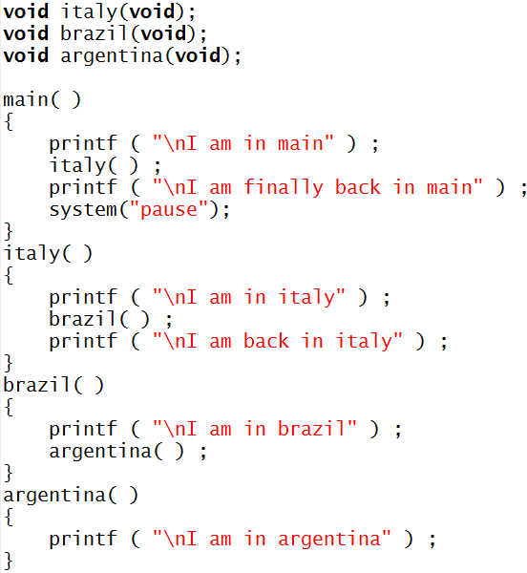
Complete program
Function prototype
Function call
Function definition

Slide 19

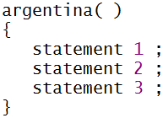
Important points
C program is a collection of one or more functions
A function gets called when the function name is followed by a semicolon. For example,
A function is defined when function name is followed by a pair of braces in which one or more statements may be present

Slide 20
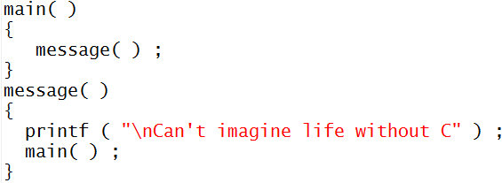
Cont.
Any function can be called from any other function. Even main( ) can be called from other functions. For example,

Slide 21
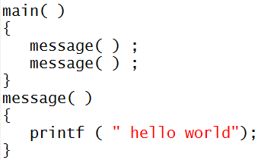
Cont.
A function can be called any number of times. For example

Slide 22
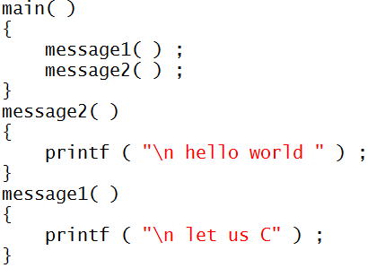
Cont.
The order in which the functions are defined in a program and the order in which they get called need not necessarily be same. For example,

Slide 23
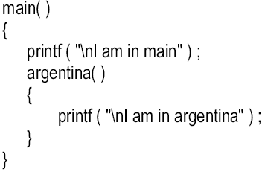
Cont.
A function can call itself. Such a process is called ‘recursion’
A function cannot be defined in another function
There are basically two type of functions
Library functions Ex. printf( ), scanf( ) etc.
User-defined functions Ex. argentina( ), brazil( ) etc.

